Slide 1
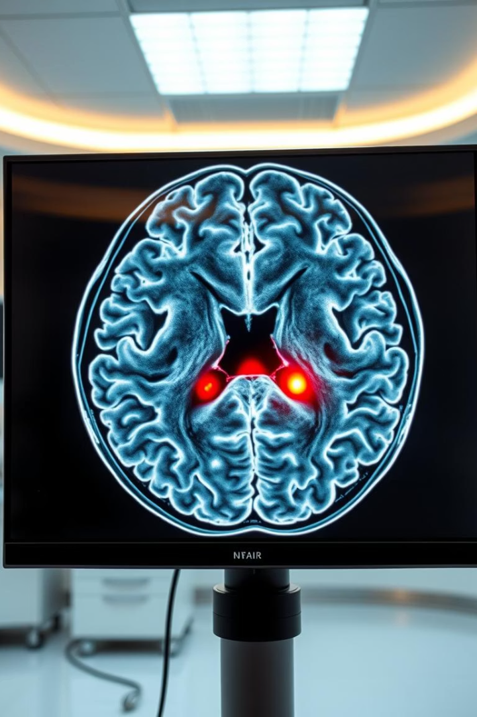

Brain Tumor Classification Using PSO-Optimized CNN
This presentation summarizes the development, training, and evaluation of a convolutional neural network (CNN) optimized by Particle Swarm Optimization (PSO) for brain tumor classification. The model classifies four tumor types using MRI images, leveraging advanced data augmentation and training techniques to improve accuracy and robustness.
by Farouk Mohamed

Slide 2
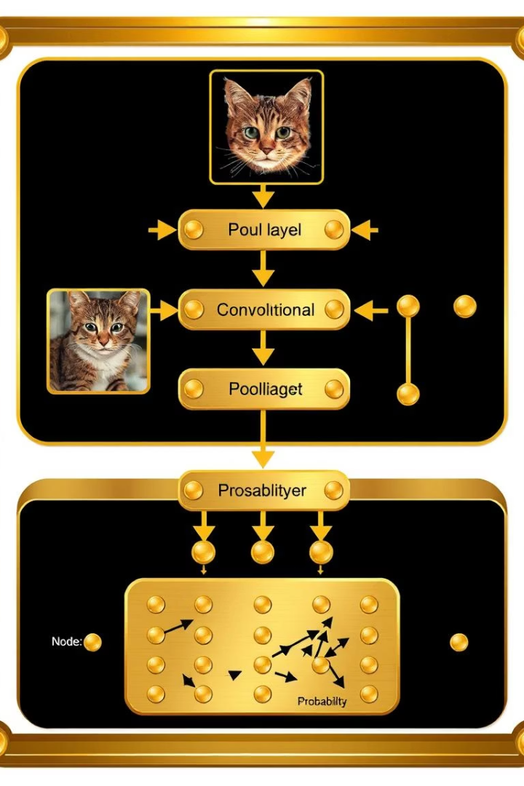
Model Architecture and PSO Optimization
Convolutional Blocks
Fully Connected Layers
Three convolutional blocks with batch normalization, ReLU activation, max pooling, and dropout layers. Filters optimized to 32, 64, and 128 respectively.
One dense layer with 512 units followed by batch normalization and dropout, leading to a 4-class output layer for tumor classification.
PSO Parameters
Learning rate, weight decay, dropout rates, filter counts, and batch size were optimized using Particle Swarm Optimization for best performance.

Slide 3

Data Preparation and Augmentation
Training Transformations
Validation and Testing
Images resized to 150x150 pixels with random horizontal/vertical flips, rotations, and color jitter to enhance model generalization.
Only resizing and normalization applied to maintain consistency and evaluate true model performance.
Dataset Split
Training set split 80/20 into training and validation subsets; test set used for final evaluation.

Slide 4
Training Setup and Process
Training Parameters
Early Stopping & Scheduler
Epochs: 50
ReduceLROnPlateau scheduler adjusts learning rate based on validation loss; early stopping applied after 10 epochs without improvement.
Batch size: Optimized by PSO
Optimizer: Adam with weight decay

Slide 5
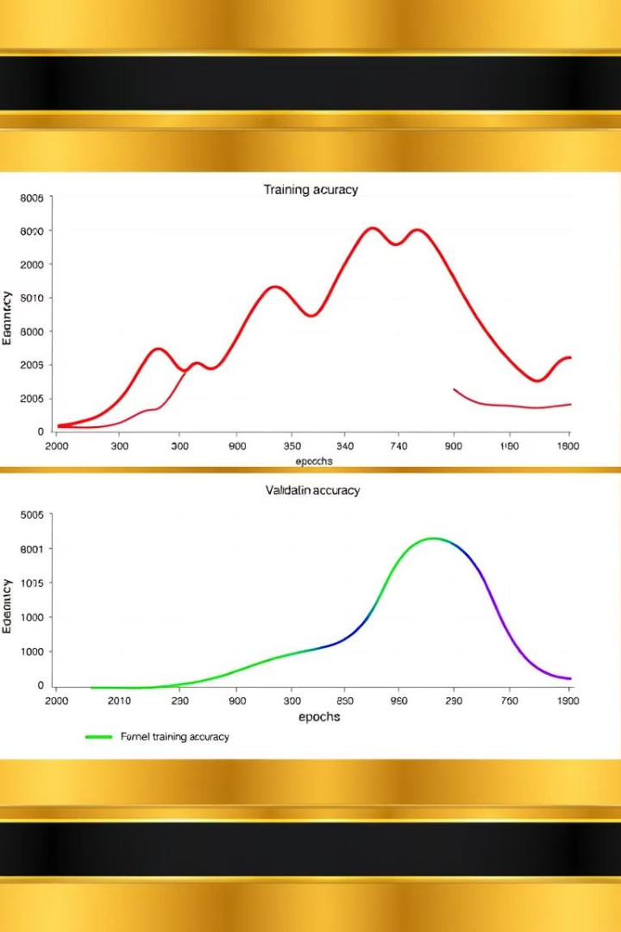



Training and Validation Performance
Loss Trends
Both training and validation loss steadily decreased, indicating effective learning and generalization.
Accuracy Improvement
Validation accuracy peaked at 95.64%, demonstrating strong model performance on unseen data.
Early Stopping
Training halted early to prevent overfitting, ensuring model robustness.

Slide 6
Test Set Evaluation
Overall Accuracy
Class-wise Performance
The model achieved 73.86% accuracy on the test set, validating its real-world applicability.
High precision for glioma and pituitary tumors
Strong recall for meningioma and no tumor classes
F1-scores indicate balanced performance across classes

Slide 7
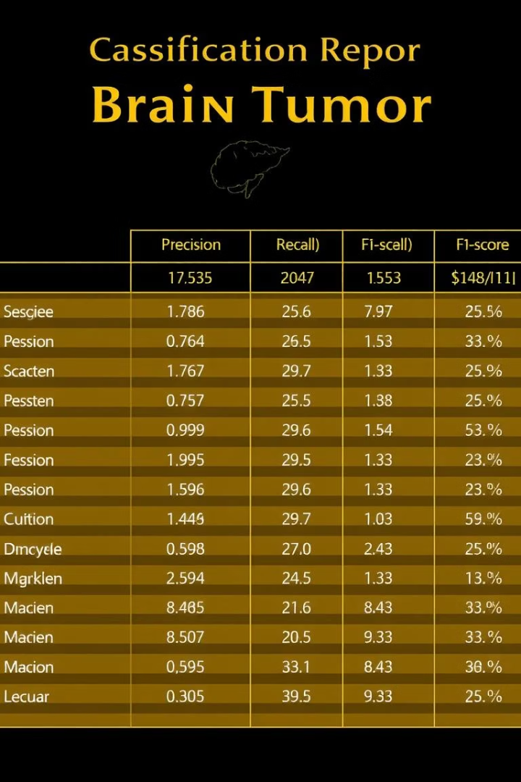
Classification Report Insights
Glioma Tumor
Meningioma Tumor
Precision 0.96 but recall only 0.22, indicating many false negatives.
Balanced precision (0.68) and high recall (0.92), strong detection rate.
No Tumor & Pituitary Tumor
High recall and F1-scores, showing reliable classification of healthy and pituitary cases.

Slide 8

Conclusions and Next Steps
Model Strengths
Areas for Improvement
Future Work
PSO optimization improved hyperparameters, achieving high validation accuracy and balanced class performance.
Low recall for glioma tumors suggests need for further data or model refinement to reduce false negatives.
Expand dataset, explore alternative architectures, and enhance interpretability for clinical adoption.

